Slide 1
Machine Learning Algorithms
Gradient Boosting (variants: Stochastic GB, Histogram-based GB, Hybrid/Adaptive variants).
Dimensionality Reduction: PCA.
Text-based Algorithm: LSTM.
Clustering Algorithm: K-Means Clustering.

Slide 2
Stochastic Gradient Boosting
Extension of standard Gradient Boosting.
Introduces randomness by:
Sampling a random subset of training data (rows).
Sampling a random subset of features (columns).
Trees are trained sequentially but on different random subsets → reduces overfitting.
Cost Function / Performance Metrics:
Same as Gradient Boosting:
Classification → Log Loss, Accuracy, ROC-AUC, F1-Score.
Regression → MSE, RMSE, MAE, R².
Use Cases:
Finance – Fraud detection (handles noisy financial transactions better).
Marketing – Customer churn prediction (avoids overfitting on biased customer data).
When to Use:
When dataset is large and noisy.
When you want better generalization and lower overfitting risk compared to vanilla Gradient Boosting.
Why we use it:
Prevents overfitting
Faster training
Better generalization

Slide 3
Histogram-based Gradient Boosting (HistGBM)
Converts continuous features into discrete bins (histograms) before training.
Training uses these bins instead of raw values → reduces computation and memory.
Trees are grown sequentially, like GBM, but split-finding is faster.
Cost Function / Performance Metrics:
Same as Gradient Boosting, optimized for speed.
Regression → RMSE, MAE, R².
Classification → Log Loss, ROC-AUC, Accuracy.
Use Cases:
E-commerce
– Large-scale product recommendation systems.
Healthcare
– Predicting disease risk on very high-dimensional datasets (lab test + genetic data).
When to Use:
When dataset is very large (millions of rows).
When speed and memory efficiency are important.
Good for real-time or near real-time applications.
Why Use?
Faster training – uses histogram binning instead of evaluating all split points.
Memory efficient – reduces memory usage by storing features as discrete bins.
Scalable – works well on very large datasets (millions of rows).
Handles high-dimensional data – performs well with many features.
Good accuracy–speed trade-off – nearly matches standard GBM accuracy but much faster.

Slide 4
Hybrid / Adaptive Gradient Boosting Variants
Combine ideas of AdaBoost and Gradient Boosting.
AdaBoost → focuses on misclassified samples with higher weights.
Gradient Boosting → minimizes a differentiable loss using gradients.
Hybrid → may use weighted residuals or modified boosting strategies.
Cost Function / Performance Metrics:
Flexible, can use:
Exponential Loss (like AdaBoost).
Log Loss / MSE (like GBM).
Evaluation metrics: Accuracy, F1, ROC-AUC (classification) / RMSE, MAE (regression).
Use Cases:
Cybersecurity – Intrusion detection (combines robustness of AdaBoost with accuracy of GBM).
Manufacturing – Fault detection (handles class imbalance effectively).
When to Use:
When dataset is imbalanced (many normal cases, few anomalies).
When you want a balance between AdaBoost robustness and GBM’s flexibility.
Mostly in research or specialized domains.
Why to use:
Combines strengths of AdaBoost & Gradient Boosting – adapts both to residual errors (GB) and reweighted samples (AdaBoost).
Better handling of data drift – adjusts faster when data distribution changes over time.
Improved robustness – reduces bias and variance simultaneously.
Flexibility – can use custom or hybrid loss functions for specialized applications.
Useful for imbalanced datasets – adaptive weighting helps focus on minority class.

Slide 5
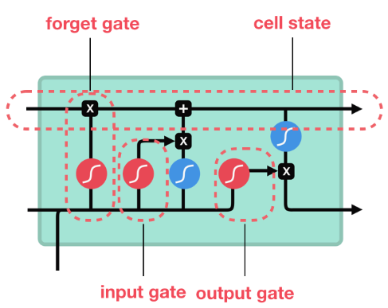
Long Short Term Memory
Core Idea: Processes sequential data using a memory cell to store and retrieve information.
Overcomes Vanishing Gradient: Solves the primary weakness of traditional RNNs.
Gating Mechanism: Three main gates regulate information flow:
Forget Gate: Decides what information to discard.
Input Gate: Decides what new information to store.
Output Gate: Determines the next hidden state.
Parameters & Hyperparameters
Parameters: Weights and biases that are learned by the model during training.
Hyperparameters (set before training):
Number of hidden units/layers: Controls model complexity.
Learning rate: Determines the step size for weight updates.
Dropout: A regularization technique to prevent overfitting.
Batch size & Sequence length: How much data is processed at once.
Why to Use LSTMs
Handles Sequential Data: Perfect for text where word order matters.
Captures Context: Excels at tasks where a word's meaning depends on words that appeared much earlier in the text.
Superior Performance: Outperforms simpler models on complex text-based tasks.

Slide 6
Cost Functions & Performance Metrics
1. For Classification Tasks (e.g., Sentiment Analysis)
Cost Function: Cross-Entropy *Categorical Cross-Entropy (for multi-class) or Binary Cross-Entropy (for binary) : Used for multi-class classification where the model must predict one out of several possible classes (e.g., classifying a review as "positive," "negative," or "neutral").
It measures the difference between the true probability distribution and the model's predicted distribution. A lower value indicates a more accurate prediction.
Performance Metrics:
Accuracy: It's the ratio of correctly predicted samples to the total number of samples.
Precision: The ratio of true positive predictions to the total positive predictions.
Recall: The ratio of true positive predictions to the total actual positives.
F1-Score: The harmonic mean of Precision and Recall.
2. For Generation Tasks (e.g., Language Modeling)
Cost Function: Categorical Cross-Entropy * The model predicts the probability of the next word in the vocabulary at each step. This cost function is used to calculate the error of these predictions.
Performance Metrics:
Perplexity: A key metric for language models. It measures how well a probability distribution or probability model predicts a sample. A lower perplexity score indicates a better, more confident, and less surprised model. For example, if a model predicts the next word in a sequence with high probability, its perplexity will be low.

Slide 7
Activation Functions
Data Preprocessing is Crucial
Tokenization: Breaking text into individual words.
Word Embeddings: Converting words into dense numerical vectors to represent their meaning.
Padding: Making all text sequences the same length for uniform input.
When to Use LSTMs
1. Your data is sequential
2. You need to capture long-term dependencies
3. The task requires context
4. You have a limited dataset for a complex task
1. Sigmoid Function (σ)
Output Range: Returns a value between 0 and 1.
Primary Role: Acts as a "gate" controller.
Why it's used: The sigmoid output range is perfect for making decisions:
A value close to 0 means "ignore" or "forget."
A value close to 1 means "remember" or "pass on."
Location: Used in the forget, input, and output gates.
2. Tanh Function (tanh)
Output Range: Returns a value between -1 and 1.
Primary Role: Creates and scales the candidate values for the memory cell.
Why it's used: The output is zero-centered, which helps the model converge more quickly and handle both positive and negative values in the cell state.
Location: Used to create the new information that may be added to the cell state and to scale the final output.

Slide 8
Use Cases for LSTMs
1. Sentiment Analysis
Goal: Classify the emotional tone (positive, negative, neutral) of a text.
Why LSTMs: They can remember context from earlier parts of a sentence or document, which is vital for understanding sarcasm or nuanced language. For example, in "The movie was so predictable, I loved it," the word "loved" is only understood as negative in the context of "predictable."
How it works: The LSTM reads the text word-by-word, and its final hidden state summarizes the entire sentence sentiment, which is then fed into a classifier.
2. Machine Translation
Goal: Convert text from one language to another (e.g., English to Spanish).
Why LSTMs: This is a sequence-to-sequence problem. An LSTM can encode the meaning of the source sentence into a fixed-length vector, and then another LSTM (a decoder) can use that vector to generate the translated sentence word-by-word.
How it works: The encoder LSTM reads the source sentence and compresses its meaning into a "thought vector." The decoder LSTM then takes this vector and generates the translated sentence, ensuring the translated words are in the correct order and have the correct meaning.
3. Text Generation
Goal: Create new, coherent, and contextually relevant text, such as in chatbots, story generators, or language models.
Why LSTMs: They can predict the next word in a sequence based on the words that came before it, learning the grammar and style of a given text corpus.
How it works: The LSTM is trained on a large body of text. When generating new text, it predicts the probability of the next word from the vocabulary, then selects one to add to the sequence and repeats the process.

Slide 9
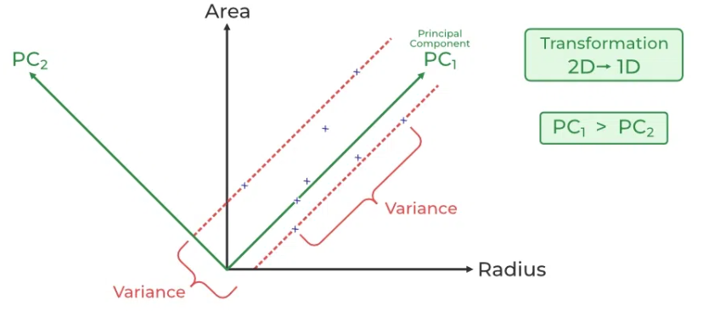
Principal Component Analysis
A dimensionality reduction technique in ML & data analysis
Converts correlated features → new uncorrelated principal components
Keeps most of the important variance/information
PCA preserves high variance to retain information while reducing dimensions
How PCA Works (Steps)
Standardize Data
Mean = 0, Standard deviation = 1
Compute Covariance Matrix
Understand how features vary together
Find Principal Components
Eigenvectors → directions of max variance
Eigenvalues → importance of each direction
Select Top Components & Transform Data
Keep k components (e.g., 95% variance)
Project data onto new axes
Key Concepts
PC1: Captures maximum variance (most important)
PC2: Next best direction, orthogonal to PC1
Components are ranked by eigenvalues (importance)
Data is projected → lower dimension while retaining structure
Why PCA is Used
To handle curse of dimensionality (many features, small samples).
To remove multicollinearity (correlated features).
To speed up training of ML models by reducing feature count.
To improve generalization by filtering noise.
For feature extraction – creates new orthogonal features.
Transform this 2D dataset into a 1D representation while preserving as much variance as possible.

Slide 10
PCA is unsupervised → it doesn’t optimize for prediction accuracy.
Instead, its objective function is:
or equivalently,
So PCA is about information preservation, not classification/regression error.
PCA Evaluation Metrics
1. Explained Variance Ratio (EVR)
Shows % of total variance captured by each principal component.
Higher EVR → component carries more useful information.
2. Cumulative Explained Variance
Sum of variance captured up to k components.
Helps decide optimal number of components (e.g., keep 95% variance).
3. Reconstruction Error
Measures how much information is lost after dimensionality reduction.
Lower error → better data representation.
4. Downstream Model Performance
Compare accuracy, training time, generalization of ML models with vs without PCA.
If performance improves → PCA is effective.

Slide 11
Advantages of PCA
Handles multicollinearity by creating uncorrelated features
Noise reduction → removes low-variance features
Enables data compression → fewer components, faster processing
Useful for outlier detection in reduced space
Disadvantages of PCA
Hard to interpret → components are combinations of features
Sensitive to data scaling (needs standardization)
Possible information loss if too few components kept
Assumes linear relationships, struggles with non-linear data
Computationally expensive for very large datasets
Risk of overfitting if too many components are used
Parameters & Hyperparameters (Scikit-learn)
n_components
Controls how many principal components are kept.
Can be set as an integer (fixed number) or float (0–1) to keep % of variance (e.g., 0.95 → 95% variance).
svd_solver
Algorithm for decomposition: "auto", "full", "randomized", "arpack".
"randomized" → fast for large datasets; "full" → exact, better for small datasets.
whiten
Scales components to unit variance → useful for Neural Nets & kNN.
Removes correlation in components but may lose some variance information.

Slide 12
When PCA is Used
When dataset has high dimensionality.
When features are highly correlated.
When visualization is required in 2D/3D.
Before applying distance-based models (kNN, clustering, SVM with RBF).
When interpretability of features is less important than variance preservation.
Real-World PCA Use Cases
1. Image Compression
High-dimensional pixel data → reduced to fewer principal components.
Keeps essential structure while discarding noise & redundancy.
Saves storage space and speeds up image processing.
2. Finance (Portfolio & Risk Management)
Reduces correlated stock returns into fewer uncorrelated risk factors.
Helps identify main drivers of market volatility.
Improves risk diversification and asset allocation strategies.
3. Bioinformatics / Genomics
Gene expression datasets have thousands of features (genes).
PCA reduces to a few key components capturing biological variation.
Useful for cancer classification, disease prediction, and biomarker discovery.

Slide 13
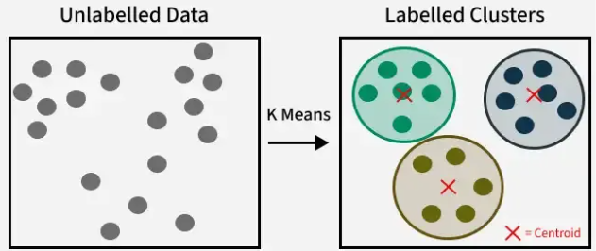
K-Means Clustering
Type: Unsupervised Machine Learning algorithm
Goal: Groups unlabeled data into clusters based on similarity
Key Idea: Assigns points to nearest cluster centroid
and updates centroids iteratively
How K-Means Works
Choose number of clusters (k)
Randomly initialize k centroids
Assign each data point to nearest centroid
(using Euclidean distance)
Update centroids = mean of assigned points
Repeat until centroids stop moving (convergence)
Parameters & Hyperparameters to Tune (K-Means)
n_clusters (k): Number of clusters (most critical choice)
init: Method for initializing centroids (random, k-means++)
n_init: Number of runs with different centroid seeds
(best result chosen)
max_iter: Maximum iterations allowed per run
tol: Tolerance for declaring convergence (stopping criterion)
random_state: Ensures reproducibility of results
Why It Is Used
Simple & easy to implement
Scales well to large datasets
Provides clear groupings based on similarity
Useful for exploratory data analysis (EDA)
K Means Clustering

Slide 14
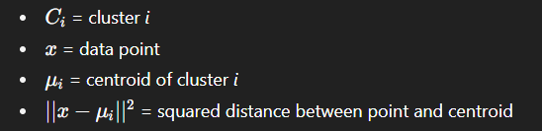
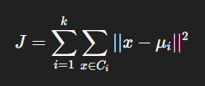
Cost Function (Optimization Objective)
K-Means tries to minimize the intra-cluster variance.
Objective function = Within-Cluster Sum of Squares (WCSS), also called Inertia.
Goal: Minimize J so that data points are close to their centroid (tight, compact clusters).
Performance Evaluation Metrics
Elbow Method
Plot WCSS vs. number of clusters (k).
Look for the “elbow point” (where WCSS reduction slows).
This point suggests optimal k.
Silhouette Score
Measures how well points fit within their own cluster compared to others
Higher values = better-defined clusters
Davies–Bouldin Index (DBI)
Evaluates average similarity between clusters
Lower values = better separation of clusters
Calinski–Harabasz Index
Ratio of between-cluster variance to within-cluster variance
Higher values = better clustering

Slide 15
When It Is Used
When number of clusters (k) is known or can be estimated
When clusters are spherical, balanced, and separated
When interpretability of clusters is important
When dimensionality is not too high (works better with fewer features)
Real-World Use Cases
E-Commerce / Retail (Customer Segmentation)
Groups customers based on buying patterns, frequency, and spending power
Enables personalized promotions and targeted advertisements
Helps in product recommendation and loyalty programs
Finance (Fraud Detection & Risk Analysis)
Clusters transactions to detect unusual spending behavior
Identifies risky loan applicants based on credit profiles
Helps in segmenting investors for portfolio management
Healthcare (Medical Data Analysis)
Groups patients based on symptoms or genetic data for better diagnosis
Clusters medical images (e.g., MRI scans) for pattern recognition
Helps in drug discovery by clustering molecules with similar properties

